Slide 1
🔌 Network Analysis
DevTools Basics

Slide 2
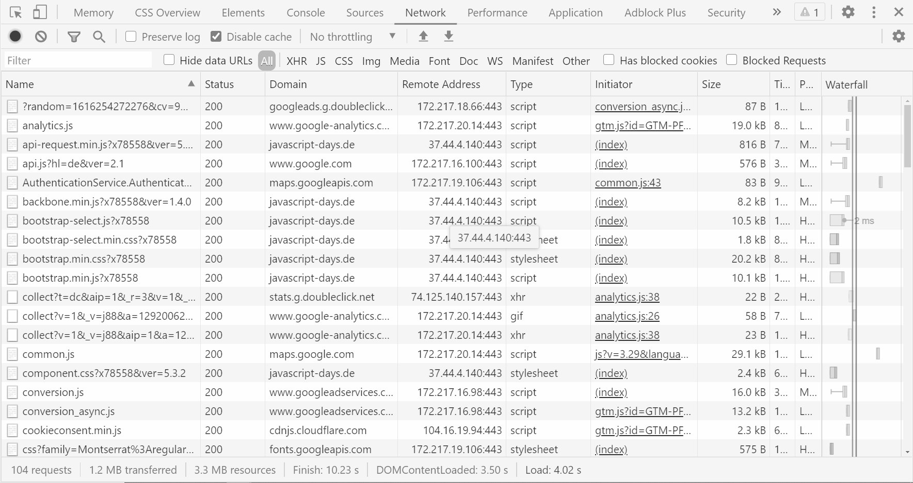

Slide 3
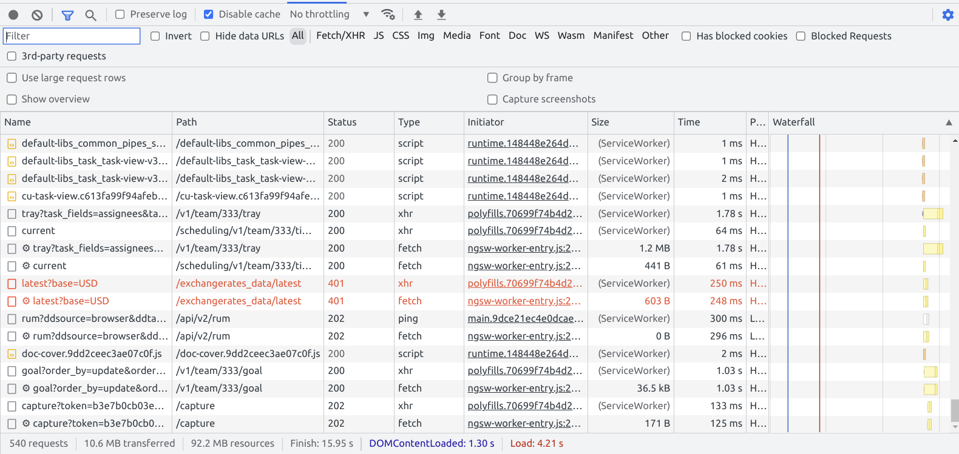
🔢 Overview
540 requests
10.6 MB transferred
92.2 MB resources

Slide 4
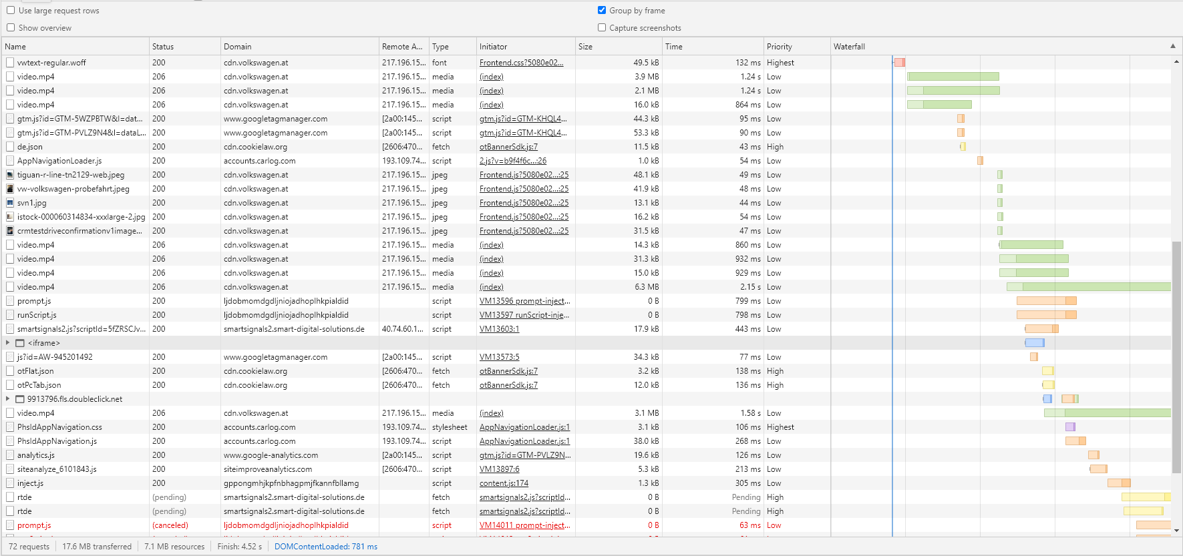
📊 Waterfall

Slide 5
🔗 Request Chaining
🔗

Slide 6
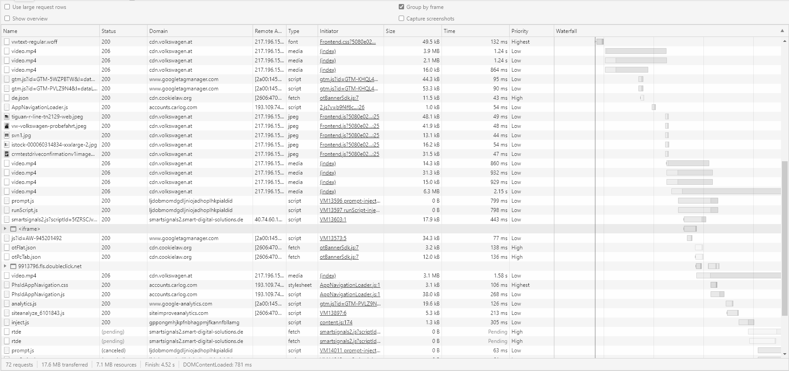
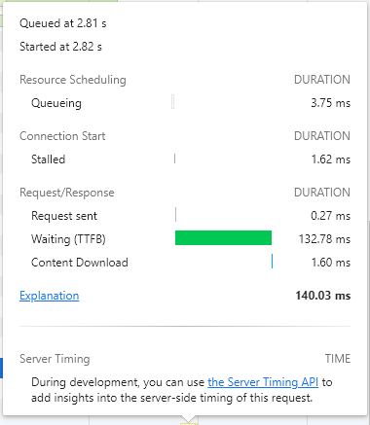

⏱ Request Timing
⏱

Slide 7
🔀 Request Priority
Prioritize
Medium
High
Low
Highest

Slide 8
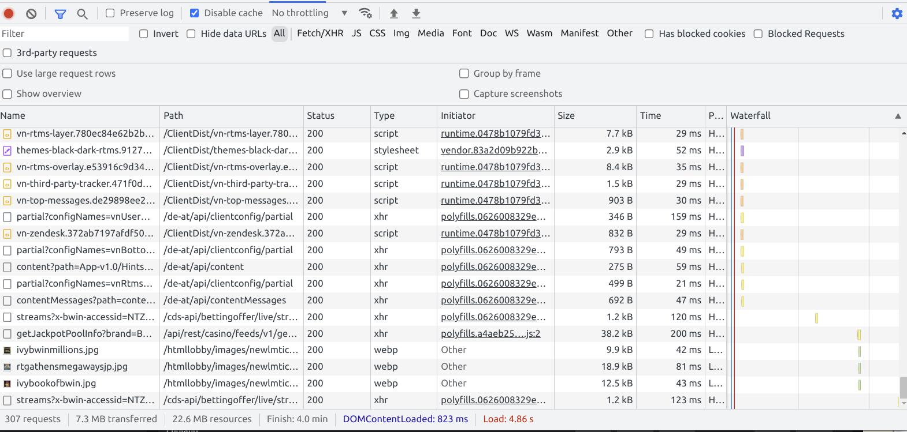
🔎 Filter & Search

Slide 9
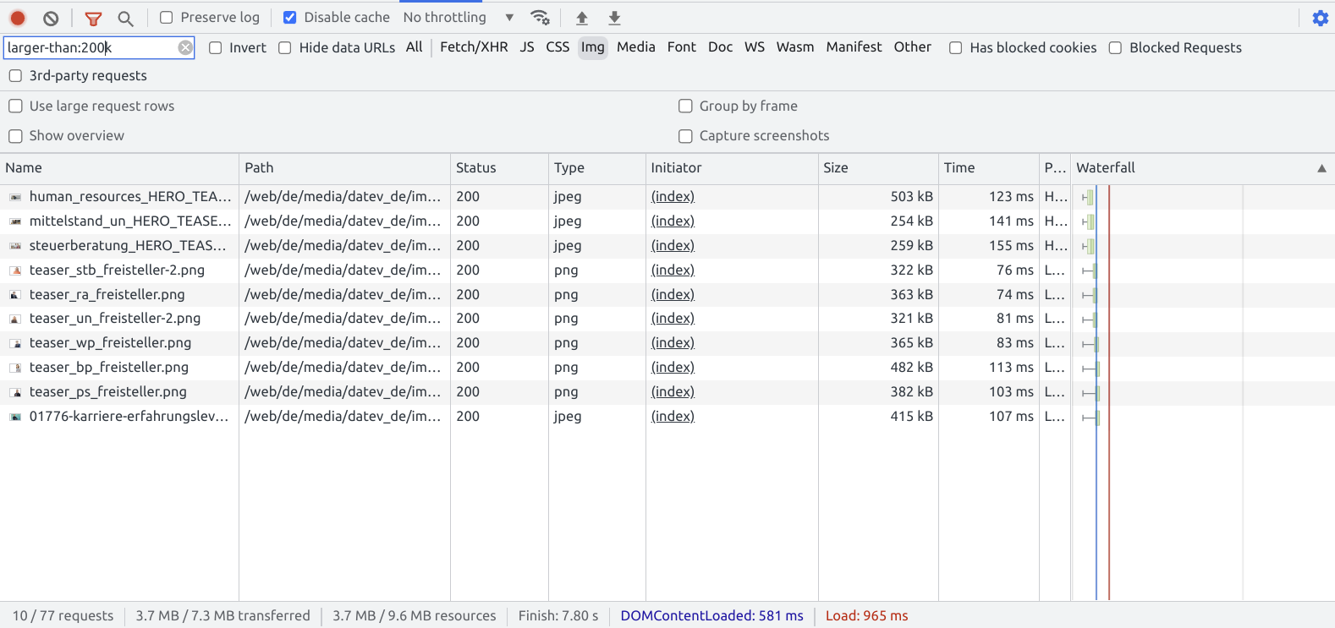
🔎 Advanced Filtering
Images that are larger than 200kB

Slide 10
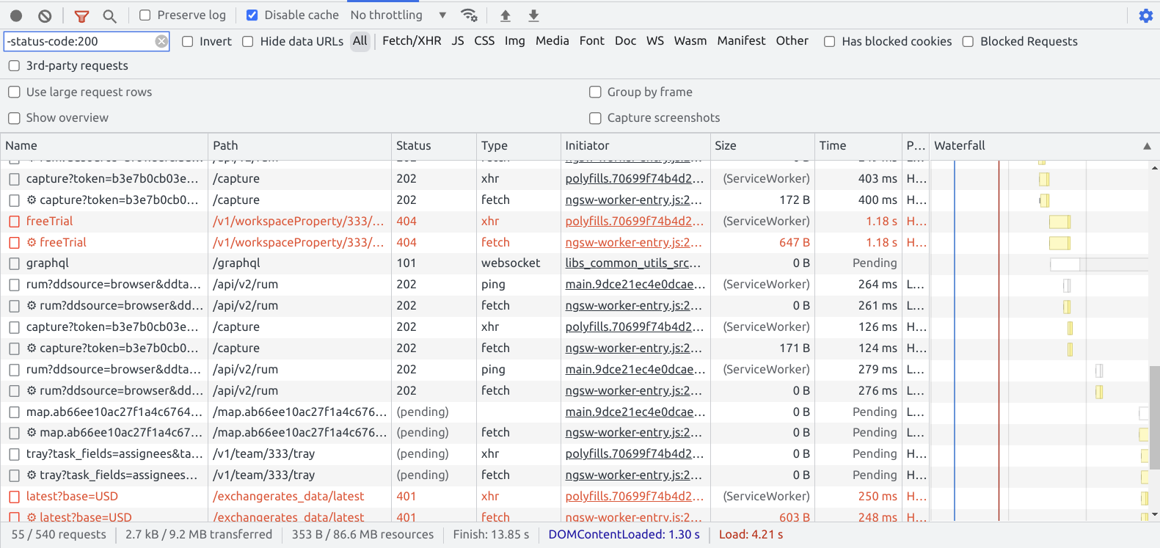
🔎 Advanced Filtering
all requests with other (-) status than 200

Slide 11
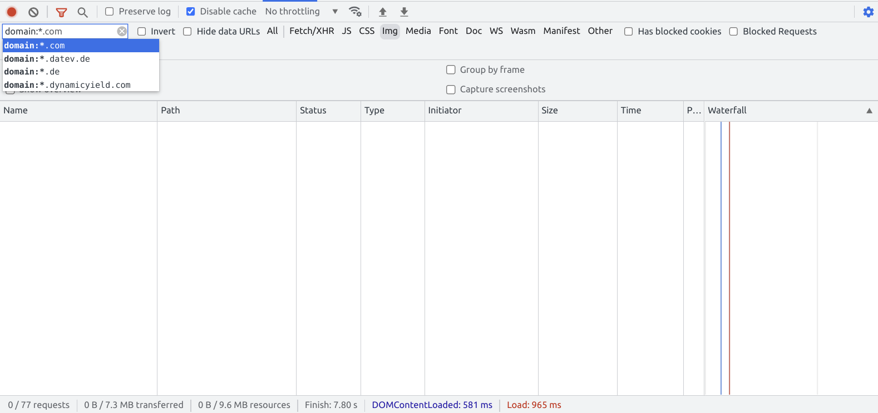
🔎 Advanced Filtering
smart autocompletion

Slide 12
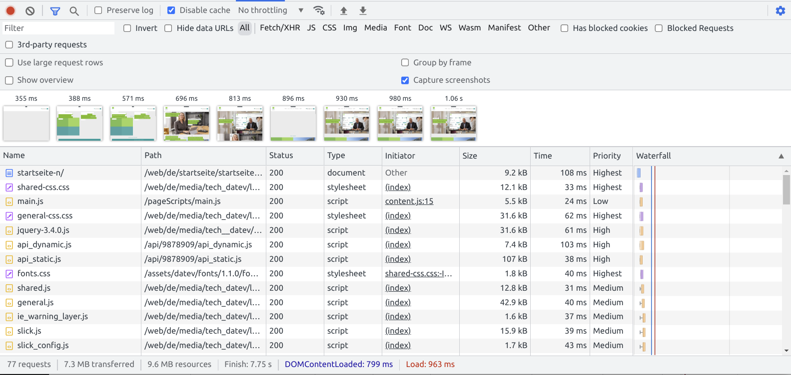
🎞️ Capture Screenshots

Slide 13
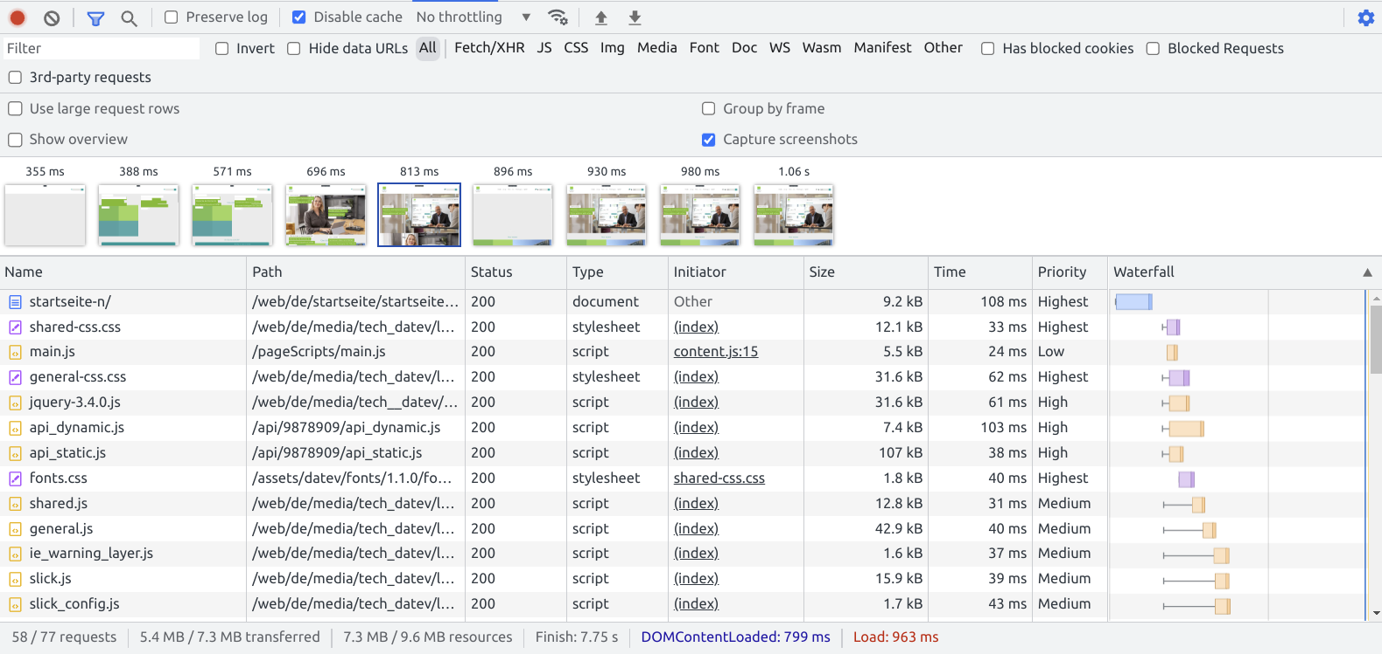
🎞️ Capture Screenshots
watch state at a given point in time

Slide 14

Demo Time!
Network Tab

Slide 15
Resource Hints
💡

Slide 16
⏱ Improve Connection Time

Slide 17
Unoptimized
connecting
downloading
connecting
downloading
main.js
fetch('https://cdn.domain.io/data');
fetch('https://api.domain.io/data');
Steps to establish a connection:
Look up the domain name and resolve it to an IP address.
Set up a connection to the server.
Encrypt the connection for security.
https://web.dev/preconnect-and-dns-prefetch/

Slide 18
Unoptimized
connecting
downloading
connecting
downloading
connecting
downloading
connecting
downloading
Optimized (with preconnect)
index.html
💡
<link rel="preconnect" href="https://cdn.domain.io"> <link rel="preconnect" href="https://api.domain.io">

Slide 19
Demo Time!
Preconnect

Slide 20
💤 Lazy Loaded Resources

Slide 21
Unoptimized (no loading set)
fetching
rendering
fetching
rendering
fetching
rendering
fetching
renderin
Optimized (with lazy loading )
index.html
💡
<img loading="lazy"/> <iframe loading="lazy"></iframe>

Slide 22
Priority Hints
💡

Slide 23
Preload, Prefetch and Priorities

Slide 24
Preload & Prefetch
preload
prefetch
Preload a resource needed for the current page (scripts, images, …) priority: high, or determined by as attribute
Prefetch a resource might be useful for future navigations priority: lowest
index.html
<link rel="preload" href="hero1.png" as="image">
<link rel="prefetch" href="not-found.png">
💡
solutions for loading critical resources for the current navigation _or_ a future navigation

Slide 25

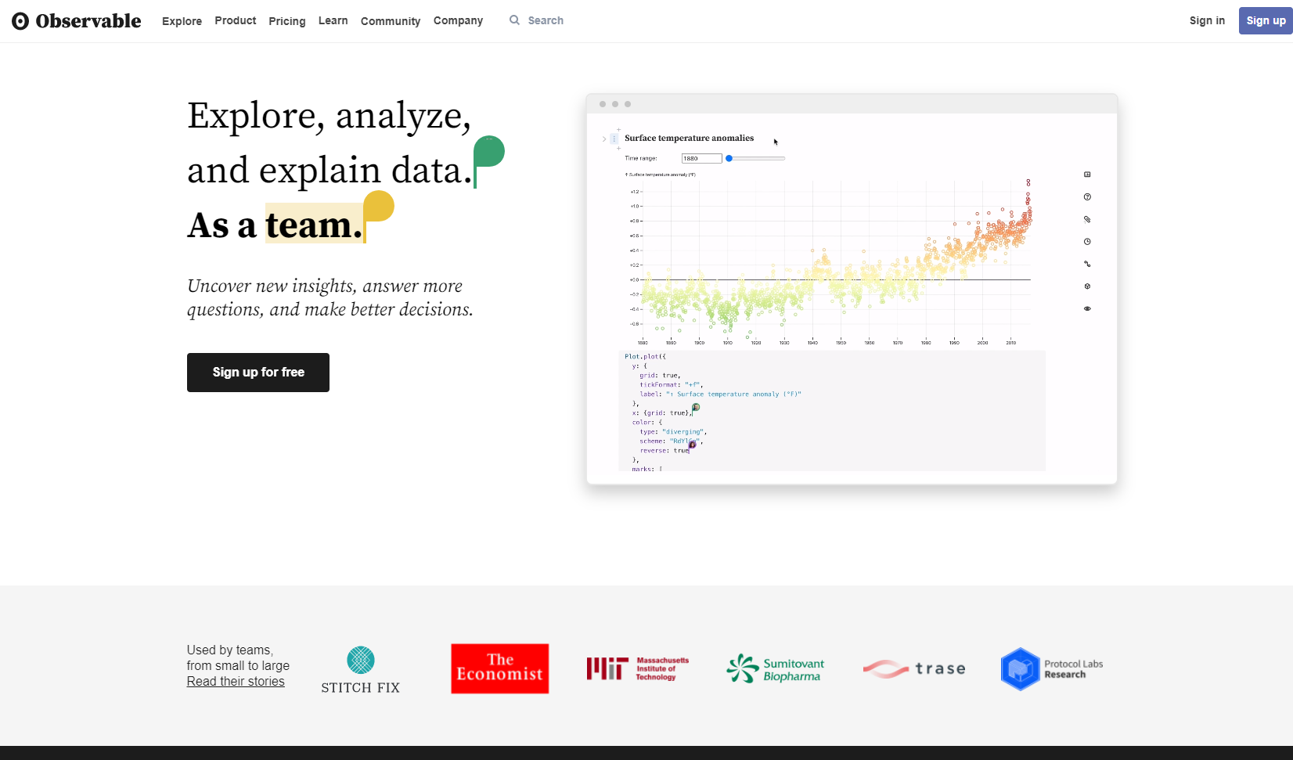
ObservableHQ - Main Page Desktop

Slide 26
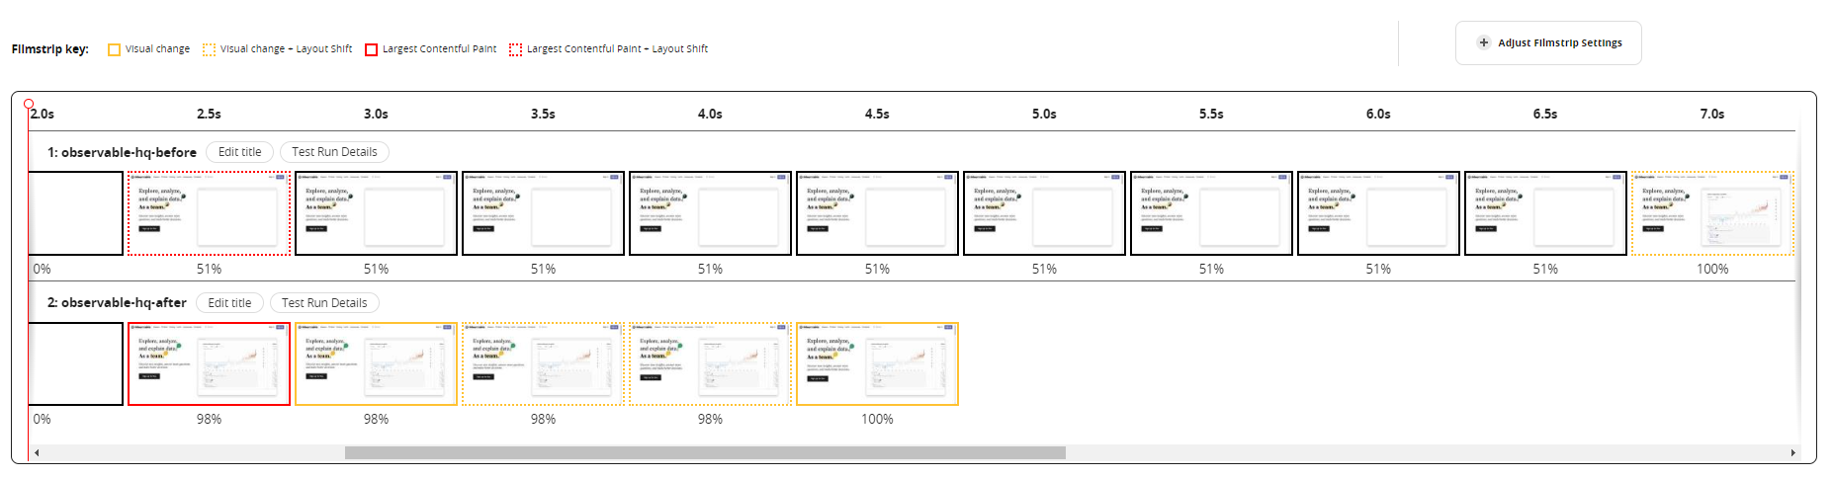
🔗observablehq.com

Slide 27
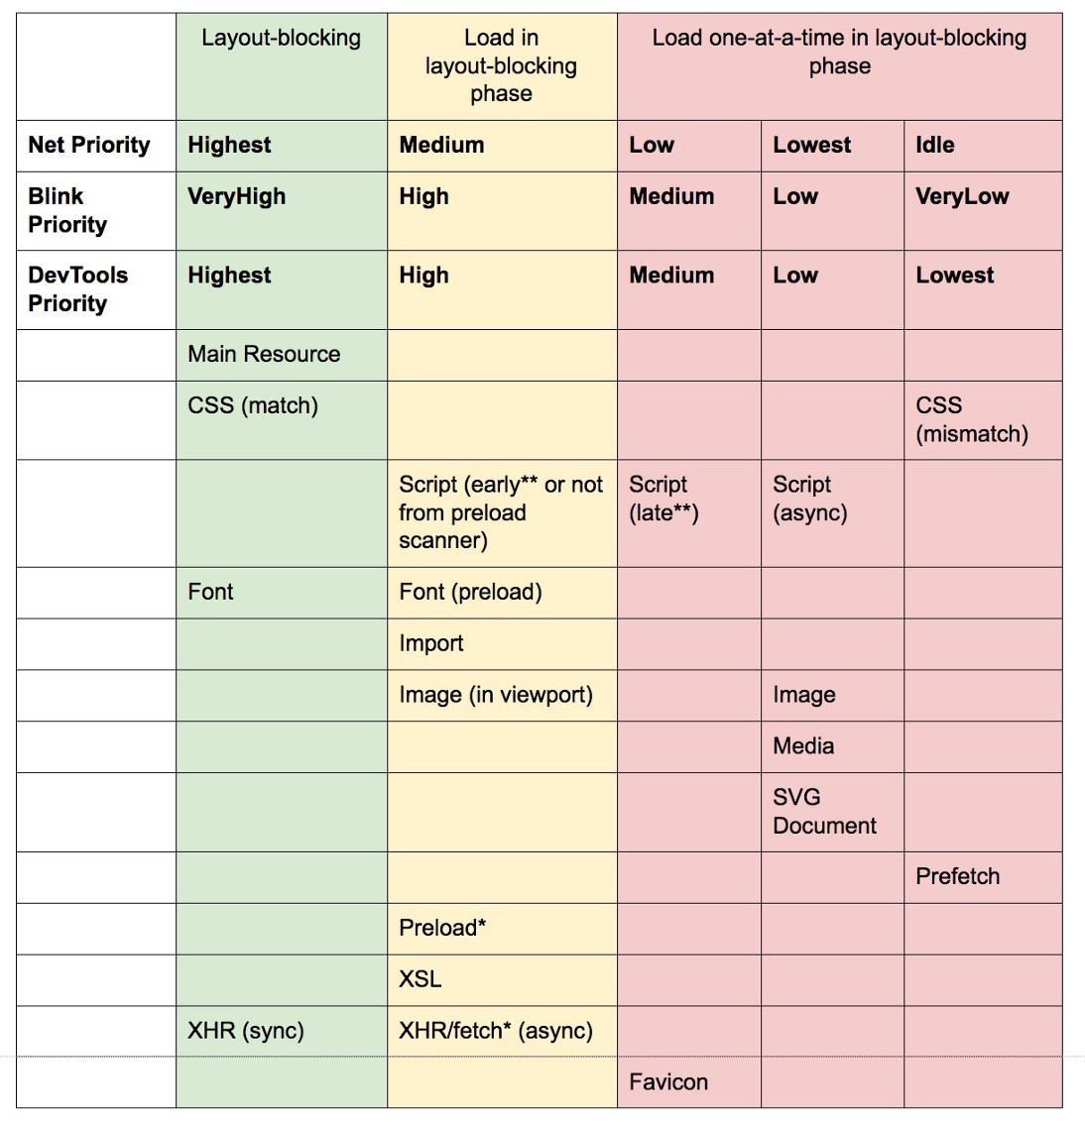
Priorities
index.html
<!-- high priority -->
<link rel="preload" href="hero1.png">
<!-- lowest priority -->
<link rel="prefetch" href="not-found.png">
preload-prefetch-and-priorities-in-chrome

Slide 28
Priorities
index.html
<!-- highest priority -->
<link rel="preload" href="styles.css" as="styles">
<!-- high priority (on screen) -->
<link rel="preload" href="hero1.png" as="image">
<!-- low priority (off screen) -->
<link rel="preload" href="footer.png" as="image">
preload-prefetch-and-priorities-in-chrome

Slide 29
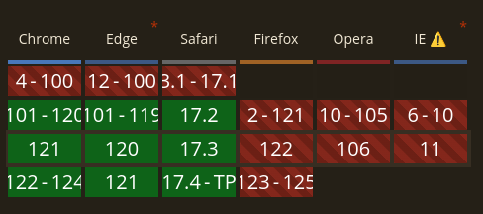
Priorities: Priority Hints
Browser Compatibility
index.html
<!-- high priority -->
<link rel="prefetch" href="footer.png"
fetchpriority="high">
// low priority
fetch('/api', {
priority: 'low'
});
https://wicg.github.io/priority-hints/

Slide 30
Demo Time!
Preload & Prefetch

Slide 31
🔗 Prefetch LCP data

Slide 32
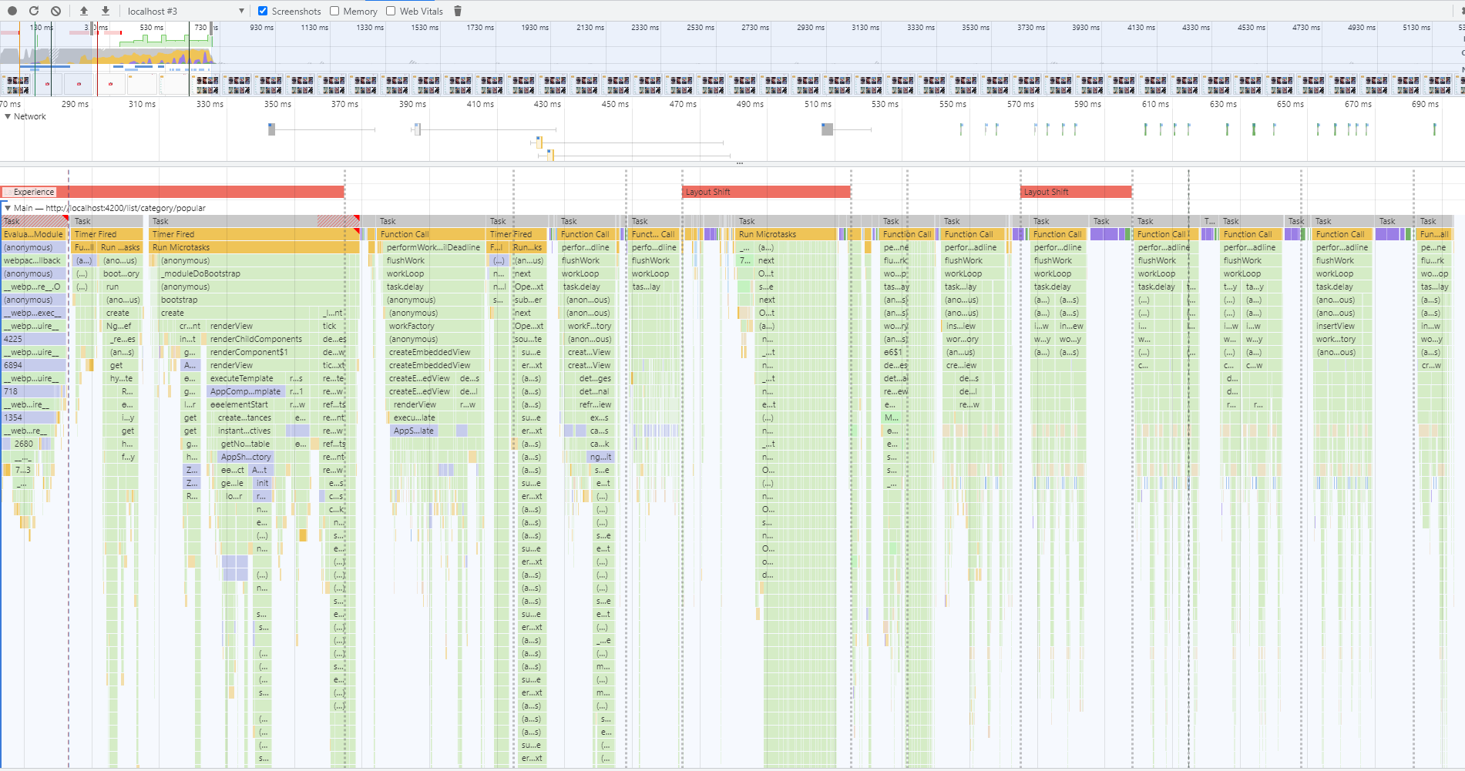

HTTP request
HTTP request
Main List Init
Sidenav Init

Slide 33
Prefetch LCP data
/**
* Fetch data included in main content on app initialization
* to reduce time of Largest Contentful Paint (LCP).
*/
providers: [
{
provide: APP_INITIALIZER,
useFactory: (state) => () => state.init(),
deps: [GlobalState]
multi: true
}
]

Slide 34
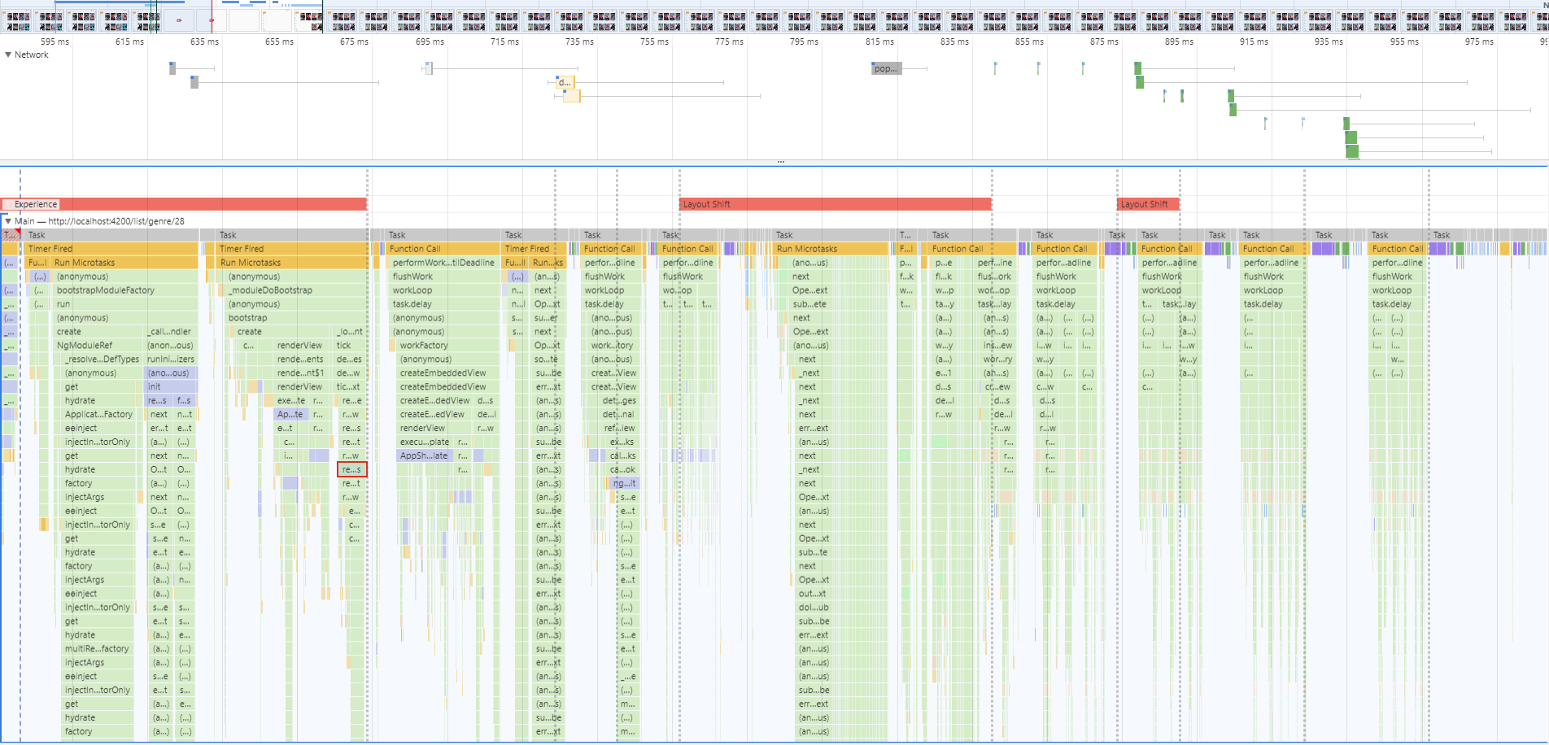
Main List Init
App init
Sidenav Init

Slide 35
Demo & Exercise
Time!
Prefetch HTTP Resources Exercise: Network Analysis & Improvement

Slide 36
⚙️ Control Request Flow

Slide 37
Control Request Flow
💡
RxJs flattening operators

Slide 38
⚙️ Control Request Flow Abort in-flight requests

Slide 39
Control Request Flow Abort in-flight requests
Navigate
|
/movie/list/popular
|
Navigate
|
/movie/list/top_rated
|
t
💡
Multiple requests have to be processed

Slide 40
Control Request Flow Abort in-flight requests
Navigate
|
cancelled
/movie/list/popular
Navigate
|
/movie/list/top_rated
|
t
🔥
Cancel not needed requests

Slide 41
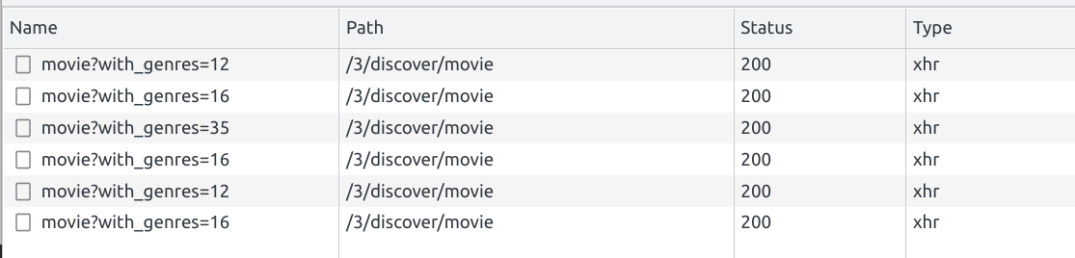
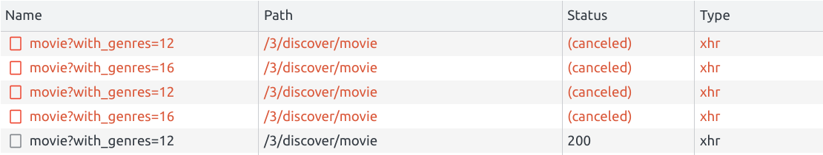
Control Request Flow Abort in-flight requests

Slide 42
Demo & Exercise
Time!
Demo: Cancel in-flight HTTP Requests Exercise: Network Analysis & Improvement

Slide 43
⚙️ Control Request Flow Prevent over emissions

Slide 44
Control Request Flow Prevent over emissions
some.component.ts
onClick() {
this.api.login()
.subscribe();
}

Slide 45
Control Request Flow Prevent over emissions
Click
|
/login
|
Click
|
/login
|
Click
|
/login
|
t
💡
Sending the same request multiple times

Slide 46
Control Request Flow Prevent over emissions
some.component.ts
click$.pipe(
exhaustMap(() => this.api.login())
).subscribe();

Slide 47
Control Request Flow Prevent over emissions
Click
|
/login
|
Click
omit action
Click
omit action
t
🔥
Omit consequent actions until first one is finished

